Slide 1
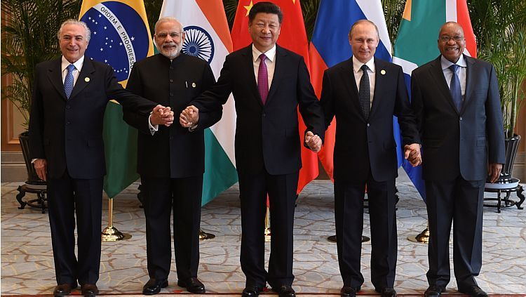
BRICS in the Arctic:
Emerging Opportunities for Collaborative Initiatives
Sergio C. Trindade
strindade@alum.mit.edu
Arctic Circle Assembly IV
Breakout Panel
15:15 – 16:45
Reykjavík, 7 October 2016

Slide 2
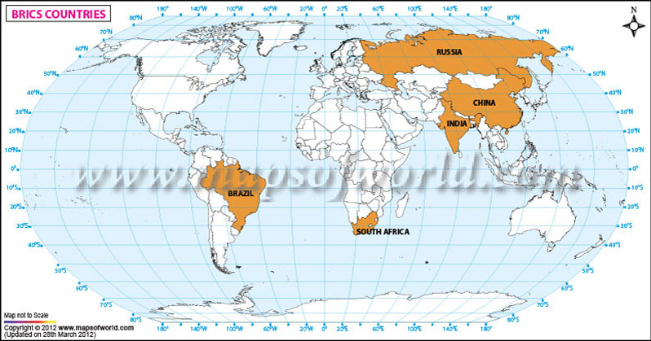
BRICS: GLOBAL WEST MOVES EAST
Initial meeting at UN-New York, 2006
First full meeting Yekateninburg, Russia in 2009:
* improving global economy * reforming int’l financial institutions
South Africa joined in 2010
VIII Annual BRIC Summit Goa, India, 15-16 Oct 2016

Slide 3
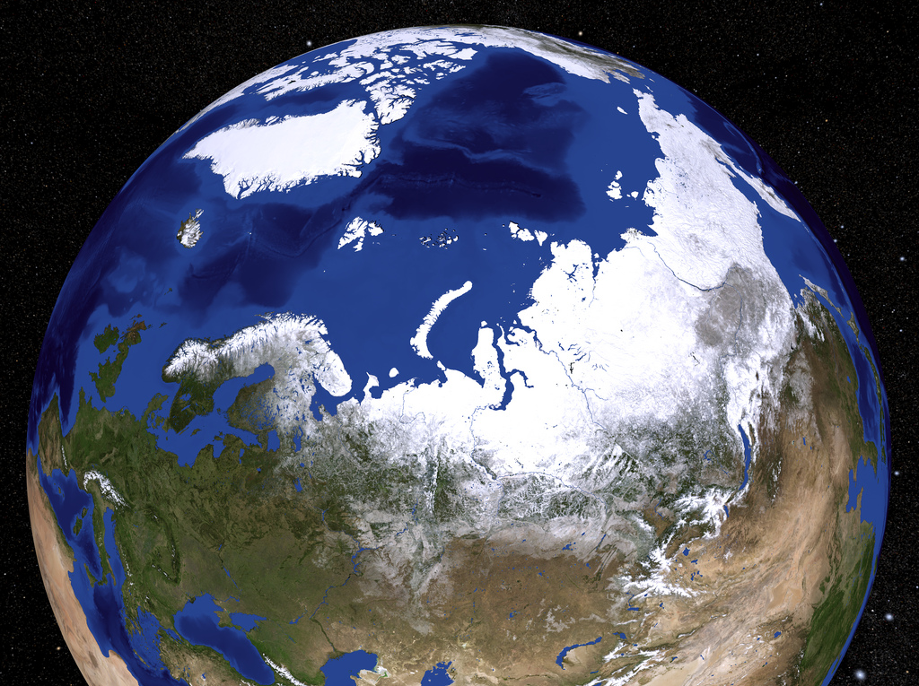
BRICS’ 3 billion population, $16 trillion GDP (20% world), $ 4 trillion reserves
Yet, not much say in international governance
Thus, BRICS as geoeconomic and geopolitical alternative to current global paradigm

Slide 4

Alternative to Bretton-Woods System
BRICS’ Contingent Reserve Arrangement
Headquartered in Shanghai
Established in July 2015
MoU with Asian Development Bank, July 2016
First regional office in Johannesburg

Slide 5
Yet, BRICS do not have much in common
Share concern about security and economic development
All but one have large land surface and are large economies
Unequal rates of economic growth

Slide 6
Russia, China and India have contiguous territory in the Northern hemisphere
Brazil and South Africa are in the Southern hemisphere
History of tensions: Russia-China and India-China
All BRICS involved in Antarctica

Slide 7
BRICS collaboration in the Arctic
Science: climate change, marine biology, glaciology, geology,…
Technology: renewable energy,
methane management, oil
Environment: human and physical
regulatory framework, disasters
Commercial: Fisheries, mining, oil and gas, shipping, ports, tourism

Slide 8
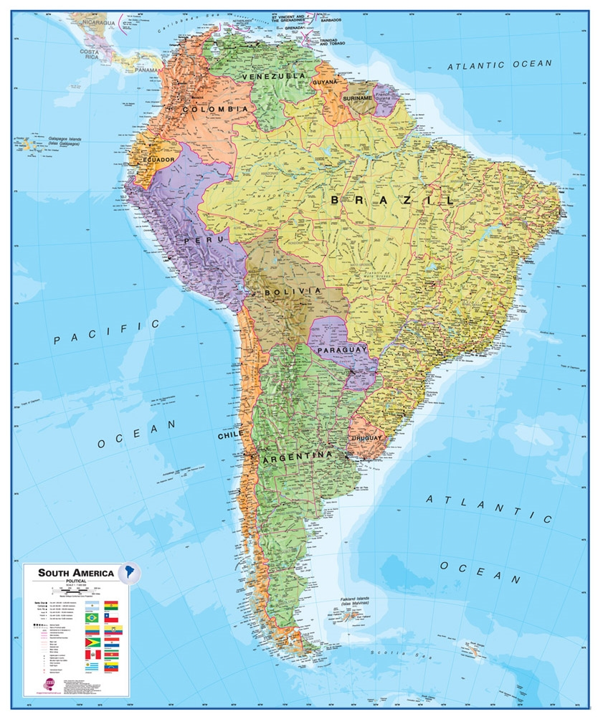
Carolina Freire
Professor of Animal Physiology, Federal University of Paraná, Brazil
Arctic work in marine ecology and commercial fisheries,
Potential partners in BRICS and other Arctic countries
Possible collaborative initiatives.
Celma Regina Hellebust
Lawyer, Honorary Vice-Consul for Brazil in Stavanger, Norway
Review of HES* oil and gas regulations in Norway
Comparison with Brazilian HES regulations
Ongoing collaborative projects involving the BRICS and/or third countries
Possible joint initiatives * HES: Health, Environment and Safety

Slide 9
Maria Lagutina
Associate Professor, World Politics Dept, St. Petersburg StateUniversity
Coordination of BRICS’ Arctic activities within the Forum
Also in the framework international institutions: United Nations, Arctic Council, IASC
Valery Konyshev
Professor, International Relations School, St. Petersburg State University
Sino-Russian cooperation in the Arctic
Alexander Sergunin
Professor of International Relations, St. Petersburg State University
Indo-Russian cooperation in the Arctic
Suggestion on BRICS’ Arctic research

Slide 10
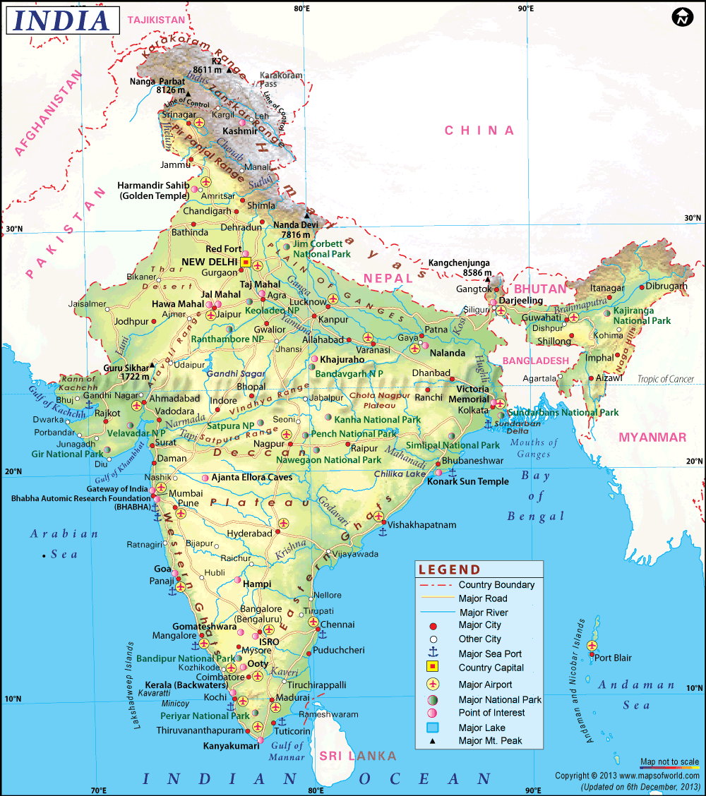
R. K. Pachauri
Internatonal Consultant
Former head of the Intergovernmental Panel on Climate Change (IPCC), India
Climate change and the future of the Arctic
Collaborative initiatives by India and other BRICS countries in the Arctic.

Slide 11
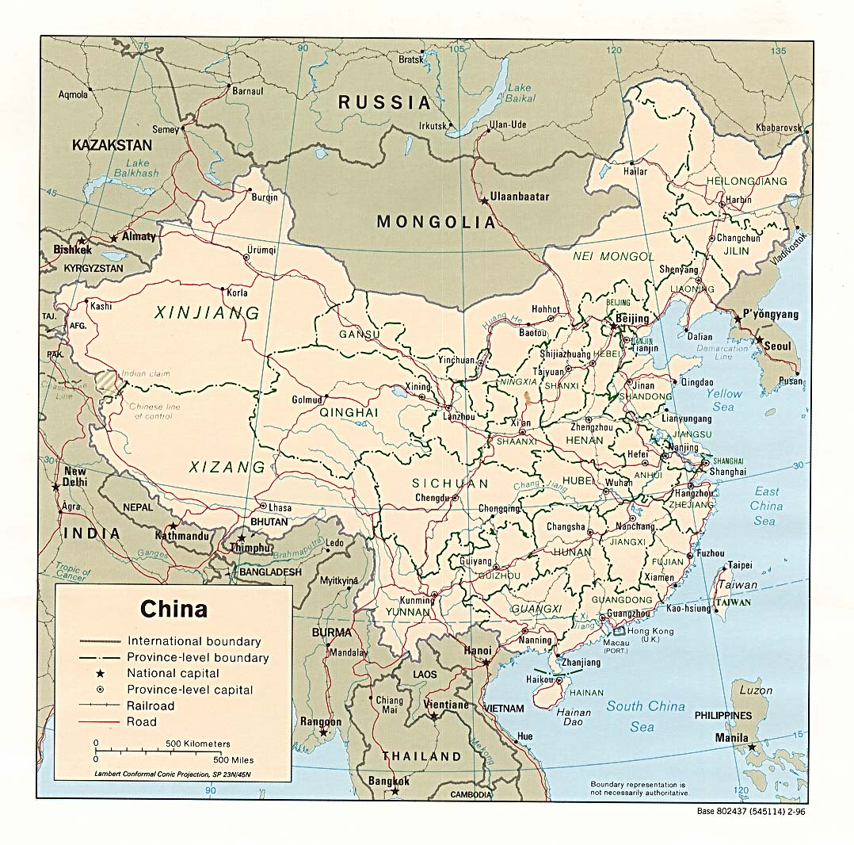
Zhang Yao
Director
Center for Maritime and Polar Regions Studies
Shanghai Institute for International Studies, China
China’s peripheral and maritime security problems, Maritime and Arctic Affairs
China’s energy security and future development options
Arctic governance and China’s role
Evolution of China’s maritime security view
China-India cooperation in Arctic fisheries and other cooperation

Slide 12
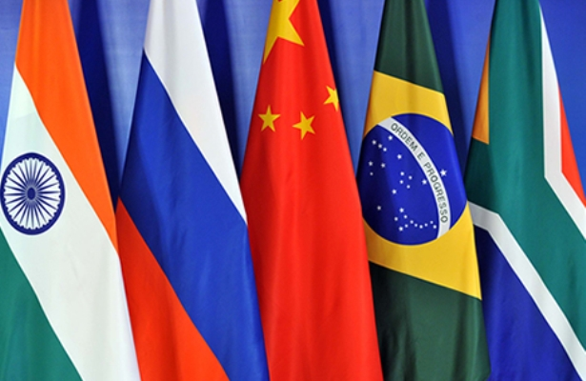
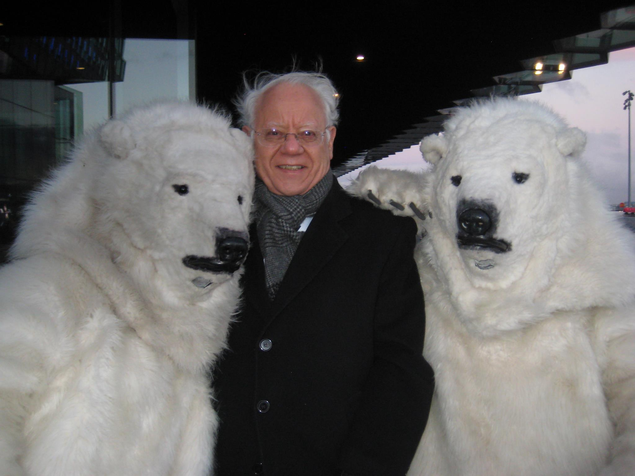
Thank you for listening!

