Slide 1
Prospects of the BRICS in the Arctic cooperation
Maria Lagutina
PhD in Political Sciences,
Saint Petersburg, Russia
2016 Arctic Circle Assembly
Reykjavik, Iceland
October 7-9, 2016

Slide 2
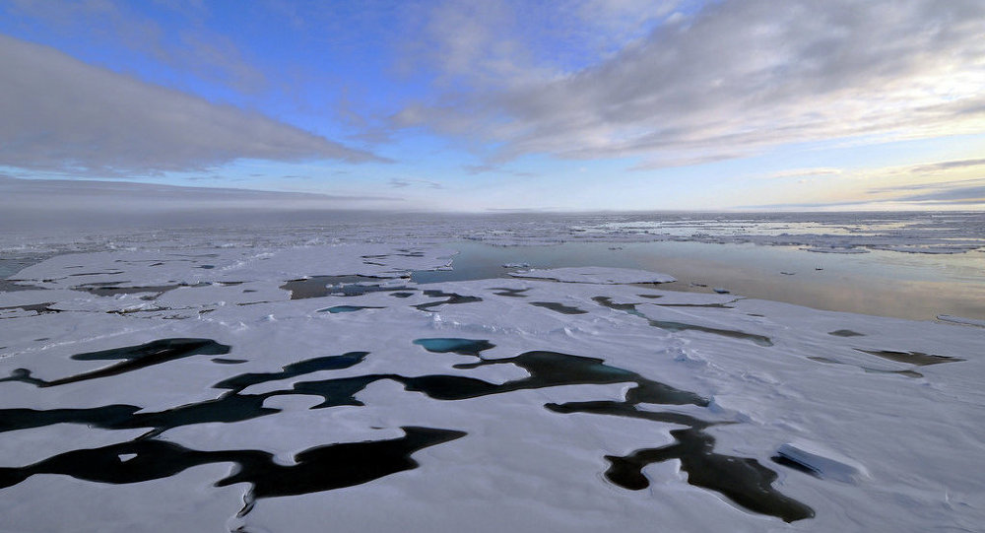
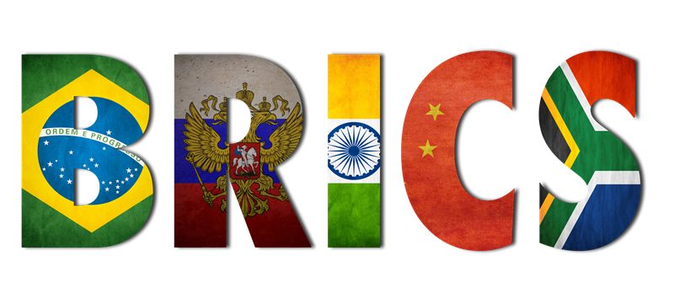
Introduction

Slide 3
Arctic cooperation: from international to transnational?
the late 1980s - the beginning of the formal international cooperation in the Arctic: the Arctic Council, Barents Euro-Arctic Council (BEAC) etc.
XXI century - transnational cooperation in the Arctic:
transnational Arctic (Lagutina M., Kharlampieva N. 2011, 2013)
Trans-Arctic (Labetskaya E., 2014, 2015, 2016)
BRIC(S) in the Arctic?!

Slide 4
The forms of cooperation in the Arctic
Bilateral Cooperation between the Arctic states and non-Arctic states;
Multilateral cooperation within the frameworks of international governmental and non-governmental organizations (for example, the UN, the Arctic Council, the Barents Euro-Arctic Council, the Northern Forum, The International Arctic Science Committee (IASC), World Wide Fund for Nature – Arctic Programme etc.);
Cooperation at the level the multinational companies (business);
Cooperation between organizations of indigenous people of the Arctic (Inuit Circumpolar Conference, Aleut International Association, Saami Council, etc.).

Slide 5
The Arctic in the BRICS’ agenda: first steps?
October 2015:
the international conference “The Approaches of the BRICS countries to governing common spaces: trends and potential cooperation“ : the issues of joint use of the Oceans and the Arctic;
a meeting of Ministers of BRICS countries on science, technology and innovation – “Moscow Declaration”:
to create a network of cooperation in the following areas:
Biomedicine, health and neuroscience;
information technology software high-performance computing;
oceanic and polar research;
coordination of nanotechnology and Photonics

Slide 6
BRICS in the system of the Arctic cooperation: forms of participation
Bilateral Cooperation between BRIC(S) states and other Arctic states and non-Arctic states:
- Russia is a major Arctic power,
- China and India since 2013 are countries-observers in the Arctic Council,
in addition, these countries are actively developing bilateral cooperation in the Arctic between each other: Sino-Russian cooperation, Indo-Russian cooperation , China-India cooperation etc.

Slide 7
2. BRIC(S) in the Arctic multilateral cooperation :
The UN – UNEP and BRIC(S):
United Nations Environment Programme Finance Initiative
The project of “green economy” and “green technologies” (2015)
The programme "Clean river of the BRICS” - UNEP, UNIDO, IUCN (2016)
The Arctic council: Russia is a full member of the AC, since 2013 China and India have observer status in the AC
The Northern Forum: the Russian regions, Chinese region - Northern Heilongjiang province;

Slide 8
3. Cooperation of the BRIC(S) multinational companies:
the Gazprom Yamal project and the China National Petroleum Corporation (CNPC)
Rosneft and CNPC (2013)
Rosneft and Indian OVL (it is a subsidiary of oil and natural gas Corporation ONGC is already a participant in the project Sakhalin-1) (2016)

Slide 9
BRICS in the system of the Arctic cooperation: areas of cooperation
BRICS may participate as the lead investor in Arctic Affairs through the BRICS Bank;
cooperation in the field of environmental protection (UNEP projects);
cooperation in the field of scientific and educational activities (International Polar Year, IASC and the BRICS network University etc.);
to ensure sustainable use of water resources and exchange of experience in water resources management;
it’s important to develop an active participation in the development of the Polar Code;
The Northern Sea Route.

Slide 10
Conclusion
Today there are yet some prerequisites for the formation of the Arctic area of cooperation of the BRIC(S) countries;
Countries B(R)IK(S) are interested in further expanding its presence in the Arctic and an active involvement in Arctic cooperation system;
Arctic cooperation can become a basis for the implementation of joint multilateral investment projects, which would raise economic interaction within BRICS to a new level;
In practice there is a lack of the institutional framework for development of the Arctic issues of cooperation, there are mostly some individual projects and bilateral cooperation.

Slide 11
Thank you for attention!
E-mail: manipolis@hotmail.com

